Slide 1





IT290 SEMINAR
DEEP DIVE
A SYSTEM RESOURCE MONITOR
Nithin S, Ayush Kumar, Jay Chavan

Slide 2
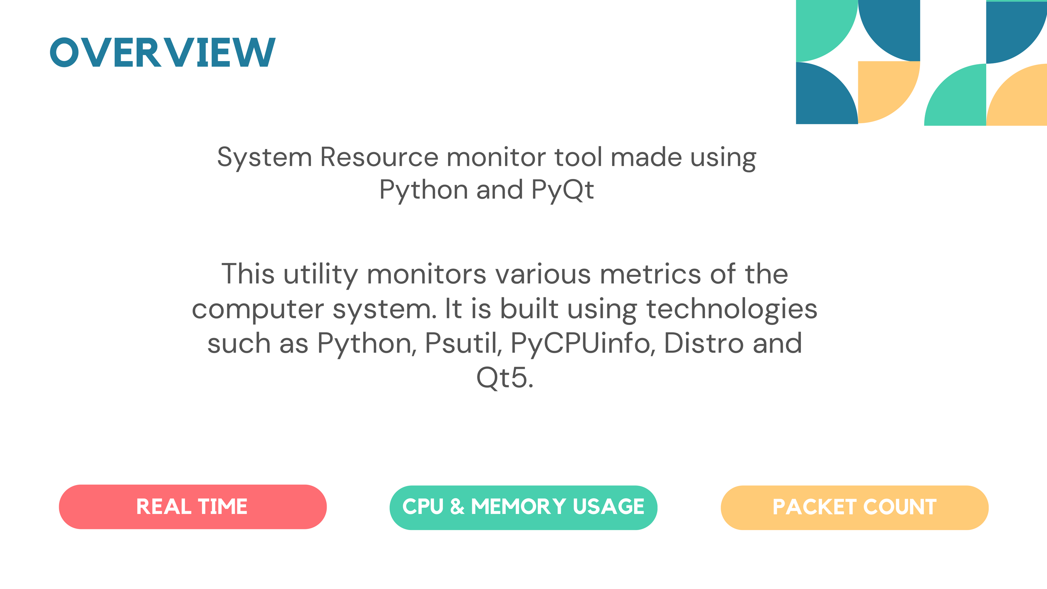

Slide 3
OBJECTIVE
CPU
Overall Usage : Percentage and Clock Speeds
Per-Core/thread: Occupancy and duration,Active Clock Speeds
Context Switches, system calls, Interrupts: Counts for software and hardware
MEMORY
Utilization and swapping rate
Usage/Availability: Percentage and size in megabytes
Partition Information: Occupancy and size of physical/logical partitions.

Slide 4
INTERNET
Global Network Statistics: Packet Count and size rate
Upload/download: Packet Count and size
Per-NIC Activity: Transfer rate,Tranmission, Dropped transfers
PROCESSES
Dynamic Process Listing: PIDs, names, terminal , usernames, states, CPU/Memory Usage
Per-Process Details: CPU/Memory usage, context switches, threads
Process Control: Kill, Resume, Terminate, Suspend Options

Slide 5
SYSTEM/HARDWARE
Software: OS, Kernel Names and Versions
Hardware: CPU Name, Vendor, Frequency, Features
VISUALLY REPRESENT REAL-TIME DATA CHANGES FOR CLEAR UNDERSTANDING.

Slide 6

SYSTEM DESIGN
User Interface
(Qt GUI)
User Interface designed using QT Designer
Collection & Processing of Data done by Python Libraries
Processing Module
(Data Analysis)
Language Used : Python
Libraries Used : Psutil, Os, PyQt5, PyCPUInfo, Distro, Numpy
Working Environment : Any Linux Distro
Requirements : A Linux Environment, Numpy, Psutil, Distro, PyQT5, PyQtGraph, PyCPUinfo,
PyQTChart
Data Collection
(System Metrics)

Slide 7
METHODOLOGY
BACKEND
while ( application running in an interval of 0.25sec )
{
Distro.name()
psutil.boot_time()
diskioqt.read_count
get_cpu_info().get("brand_raw")
get_cpu_info().get("count")
proc.info["pid"]
proc.info["name"]
psutil.cpu_percent()
time.time()
......many more shown in the report
}

Slide 8
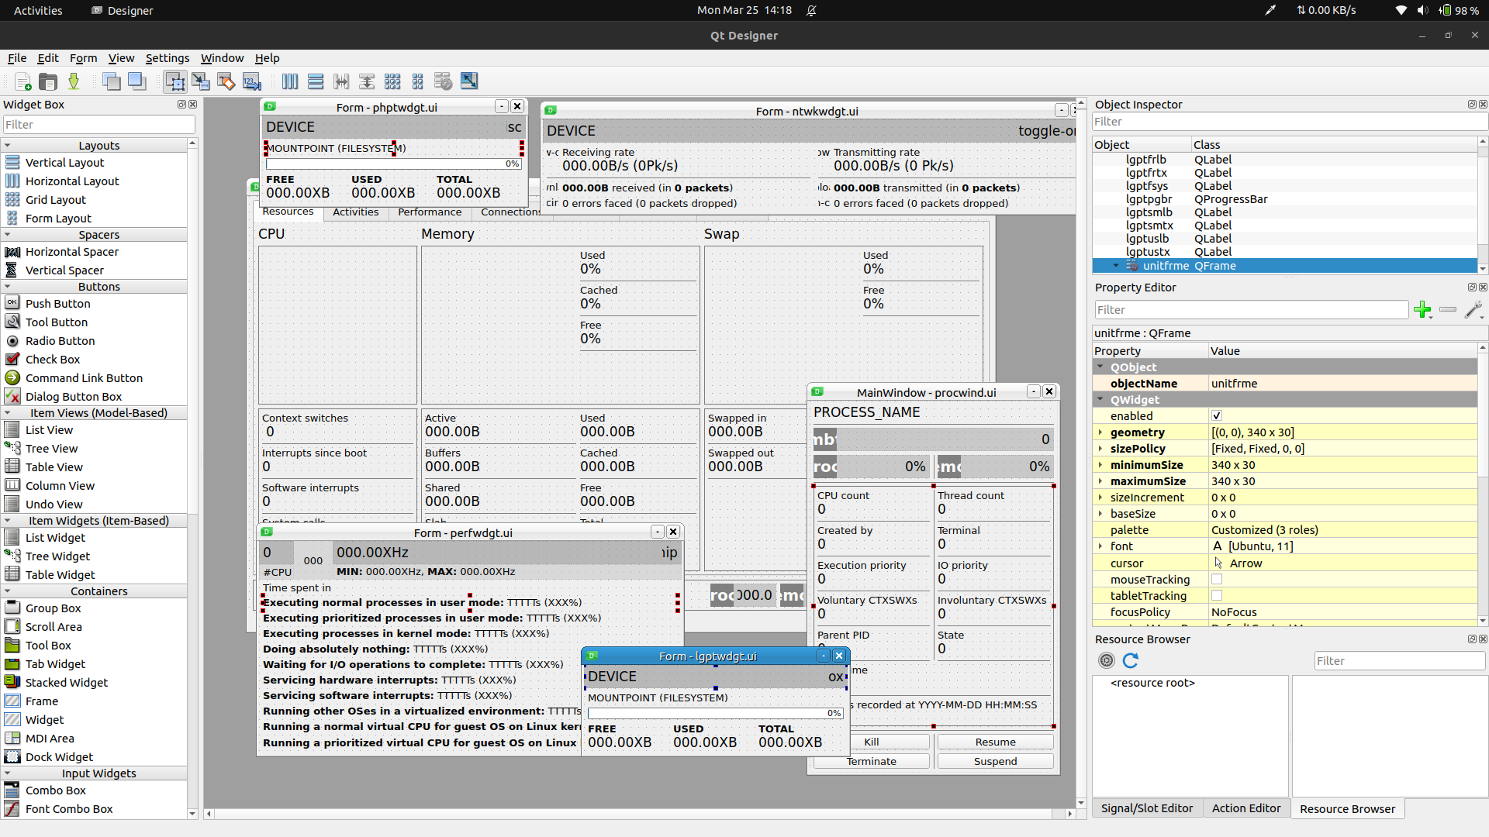
FRONTEND

Slide 9
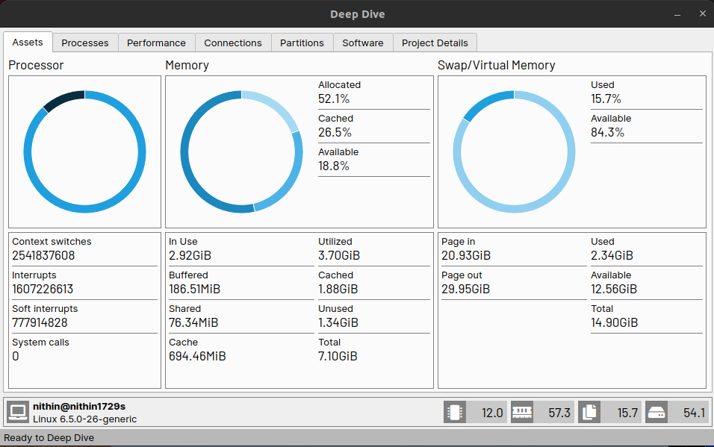
RESULTS

Slide 10
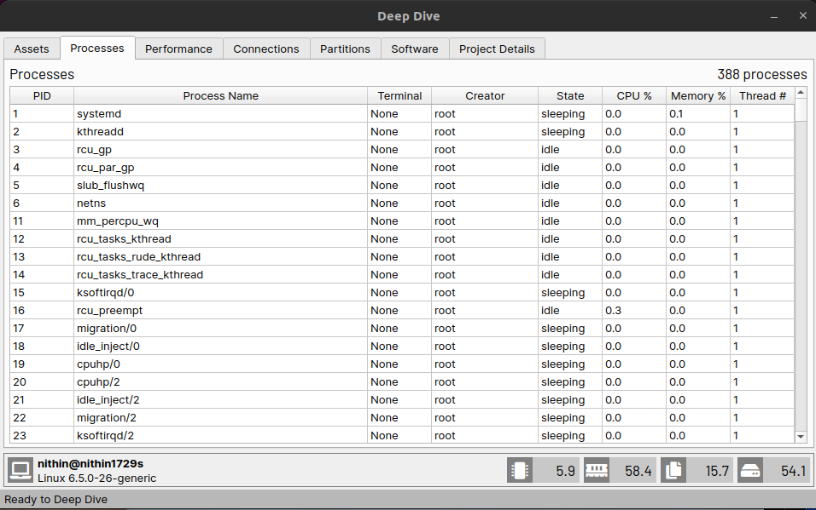
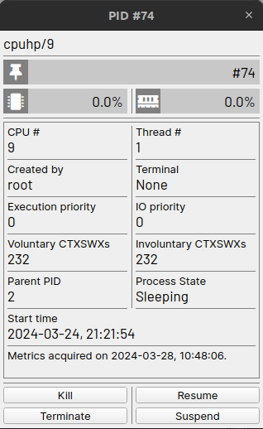

Slide 11
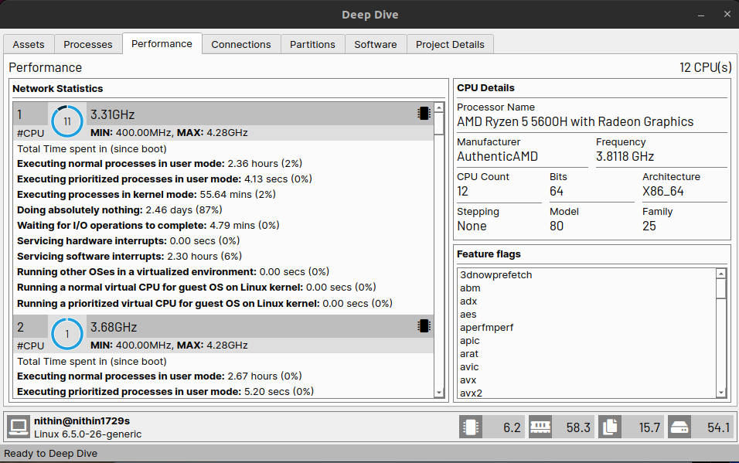

Slide 12
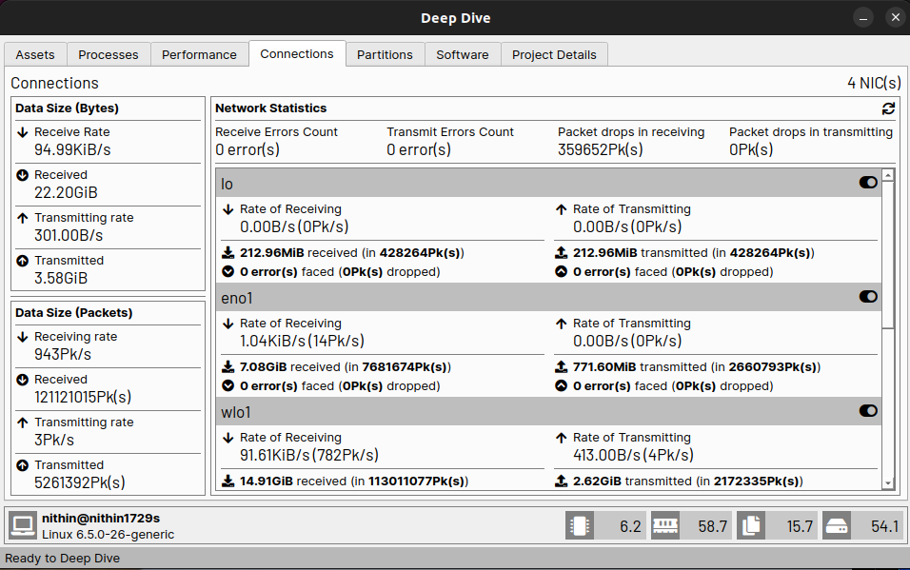

Slide 13
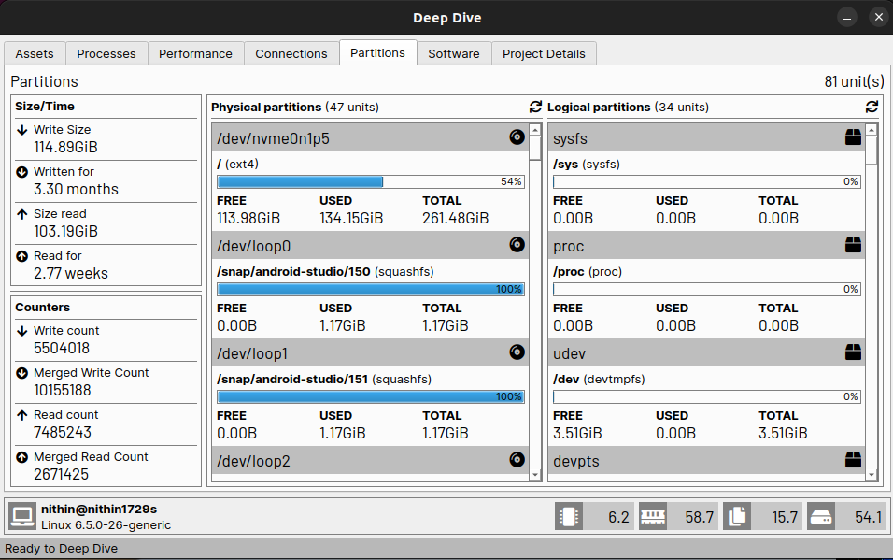

Slide 14
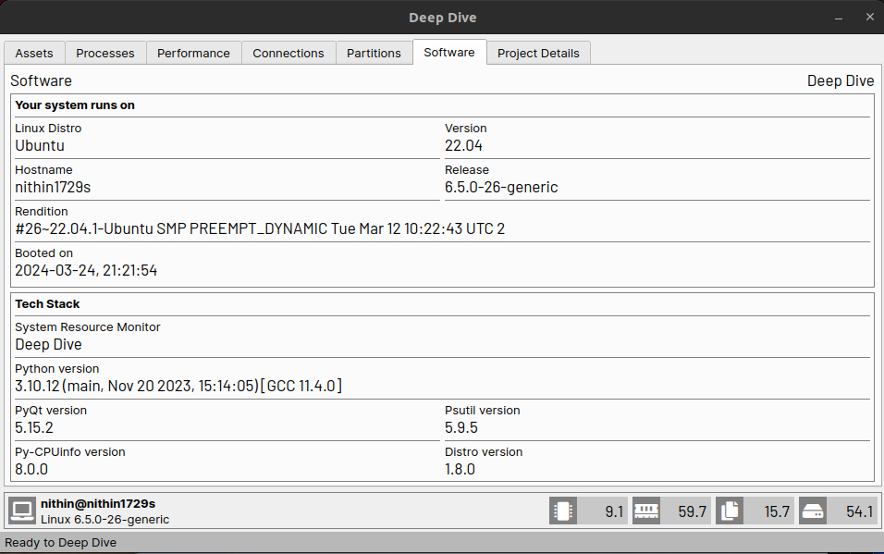

Slide 15
INDIVISUAL CONTRIBUTION
Backend Dev: Nithin S, Ayush Kumar
Frontend Dev: Jay Chavan, Nithin S
FUTURE WORK
Reducing Overhead
Better System Architecture
Integrating Alerts
Historical Data Analysis
Enable Customization
Multi Platform Support

Slide 16


